Slide 1
Early Scientists & the Cell Theory
TSW identify key scientists in the development of the Cell Theory

Slide 2
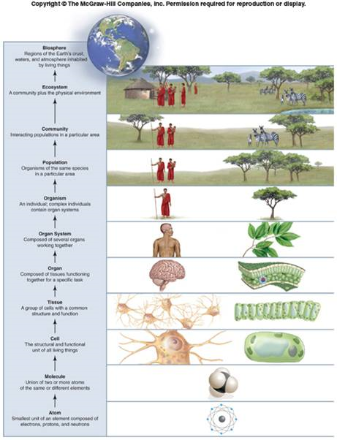
Levels of Organization
Atoms
Molecules
Macromolecules
Cells
Tissues
Organs
Organ Systems
Organisms

Slide 3
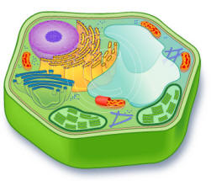
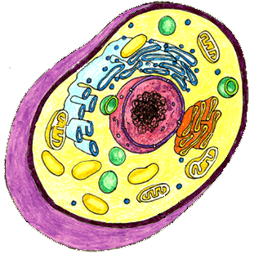
What is a CELL?
Basic unit of structure and function in living things
Cells were unknown until the invention of the microscope in the 1650’s

Slide 4
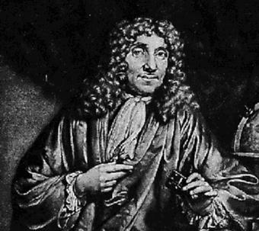
Anton van Leeuwenhoek (1632-1723)
Observed pond water, sour milk, blood and semen
Named the tiny living organisms he saw “animalcules”
Invented the 1st simple light microscope

Slide 5
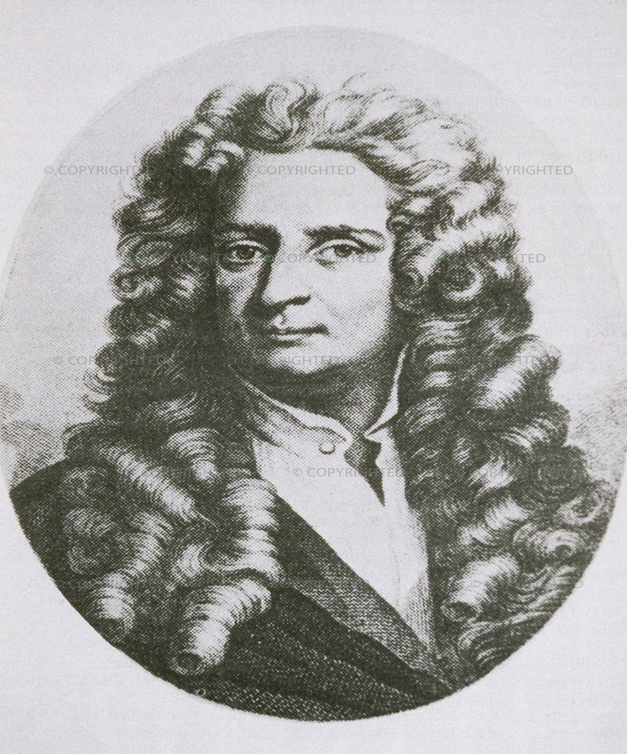
Robert Hooke (1635-1703)
Studied slices of cork
Named the structures he saw “cells” because they reminded him of the small rooms monks slept in
He was actually viewing the cell walls of plant cells

Slide 6
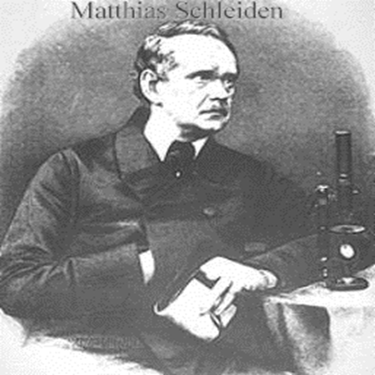
Matthias Schleiden (1804-1881)
1838: German botanist concluded that all plants are made of cells

Slide 7
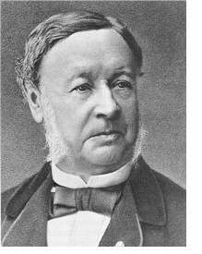
Theodor Schwann (1810-1882)
1839: German physiologist & close friend of Schleiden, concluded that all animal tissues are composed of cells

Slide 8
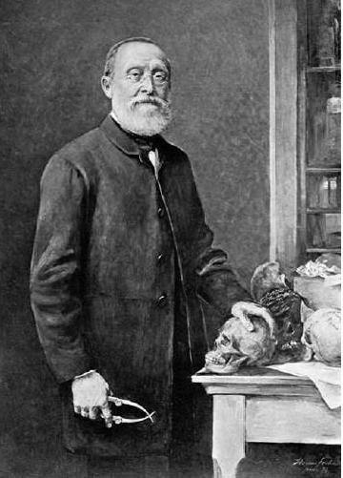
Rudolf Virchow (1821-1902)
1858: German physician, concluded that all cells come from pre-existing cells

Slide 9
3 Components of the Cell Theory
All living things are made of one or more cells
Cells are the basic unit of structure & function in living things
All cells come from pre-existing cells

Slide 10
Modern Cell Theory
The cell contains hereditary information(DNA) which is passed on from cell to cell during cell division.
All cells are basically the same in chemical composition and metabolic activities.
All basic chemical & physiological functions are carried out inside of cells.
Cell activity depends on the activities of sub-cellular structures within the cell(i.e. organelles)

Slide 11
Spontaneous Generation
Until 1850, most people believed that living things could spontaneously appear from non-living material
Ex: Mice could be “created” by putting grain in a dark, quiet place and leaving it for a few weeks
Scientists sought to disprove this idea

Slide 12
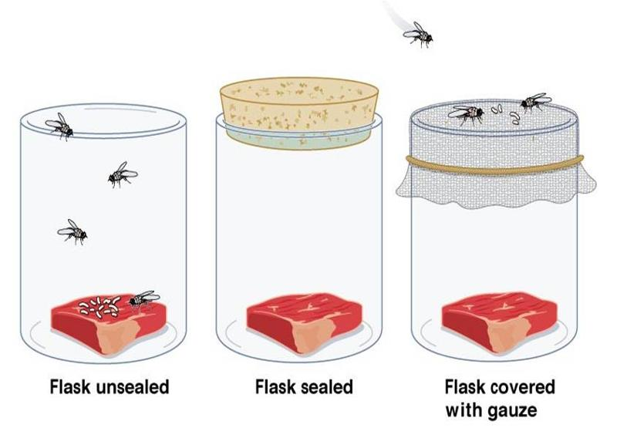
Francesco Redi (1626-1697)
1st to challenge spontaneous generation
Did not accept that flies arose from rotting meat

Slide 13
Redi’s Experiment (1668)
IV: Cover
DV: Presence of Flies
Hypothesis: If a jar containing rotting meat is covered, then it will produce no flies.
Conclusion: Flies lay eggs, eggs grow into maggots, maggots grow into flies. If flies cannot lay eggs, then no new flies will result.

Slide 14
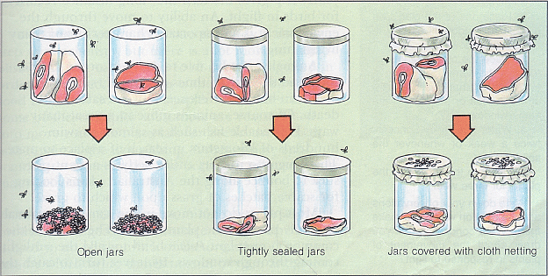

Slide 15
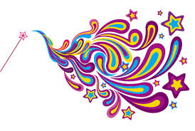
Objections to Redi
Sealing the jar kept a “magical essence” from entering the rotting meat & bringing it to life
Accepted the notion that large organisms could not spontaneously generate, but still believed that microbes arose from a “vital force” in the air

Slide 16
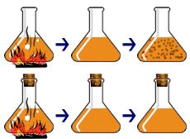
Lazzaro Spallanzani (1729-1799)
Microbes that spoil food come from the air & can be killed by boiling
IV: Air
DV: Food Spoilage
Hypothesis: If air is allowed to reach food, then microbes will get in & cause it to spoil.

Slide 17
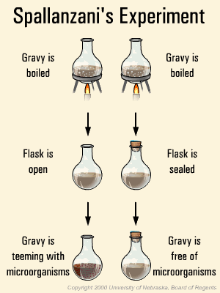
Spallanzani’s Experiment (mid-1700s)
Flask 1: Boiled broth, left open
Flask 2: Boiled broth, sealed shut
Results: Flask 1 spoiled & Flask 2 did not spoil

Slide 18
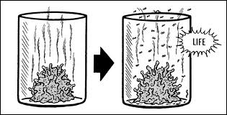
Objections to Spallanzani
Sealing the flask blocked the “magical life force” in the air from getting to the broth.
No air, no life.

Slide 19
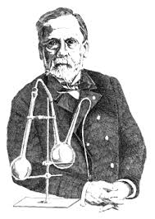
Louis Pasteur (1822-1895)
Supported the idea that spontaneous generation is a MYTH
Invented pasteurization (sterilization by heat)
Developed a special “swan-neck flask” which would allow air in but keep microbes out

Slide 20
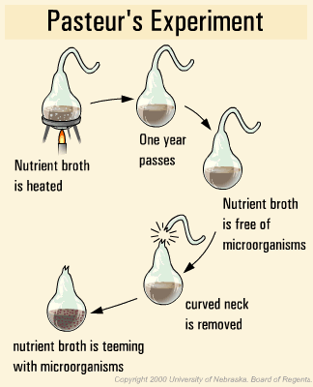
Pasteur’s Experiment (mid-1800s)
IV: Access to bacteria
DV: Spoiling broth
Hypothesis: If boiled broth is kept free of bacteria, then it will not spoil even if air can reach it.

