Slide 1
Cell Transport
TSW compare and contrast the various methods molecules move across the cell membrane

Slide 2
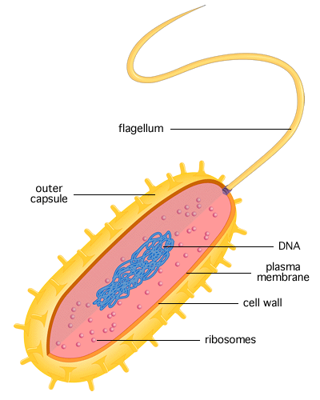
Prokaryotic Cells
Key Point: No nucleus or membrane –bound organelles
Example: Bacteria

Slide 3
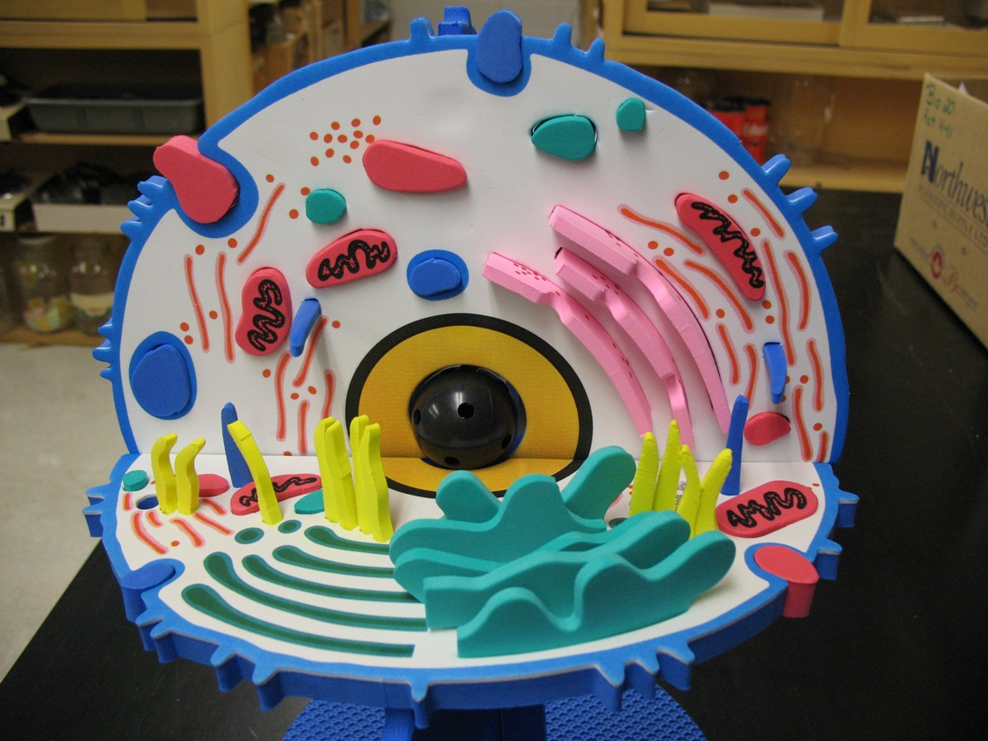
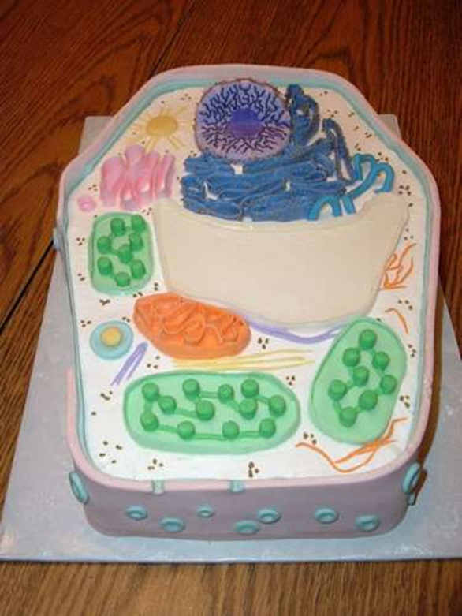
Eukaryotic Cells
Key Point: Has a nucleus and membrane-bound organelles
Examples: Plant, Animal, Fungi, Protists

Slide 4
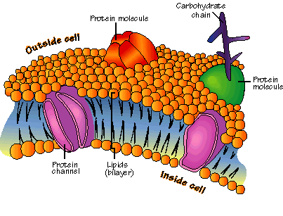
Cell Membranes
Regulate what enters and leaves the cell
Phospholipid bilayer (phosphate heads, lipid tails, protein channels)

Slide 5
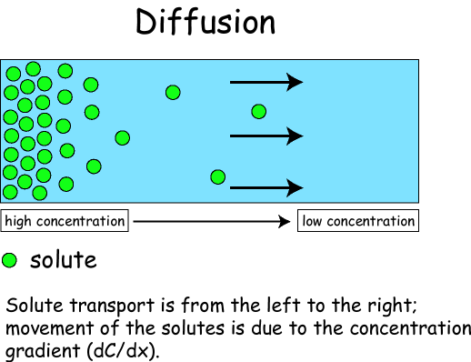
Diffusion
Movement of particles from an area of higher concentration to an area of lower concentration
Particles spread out until the concentration is equal

Slide 6
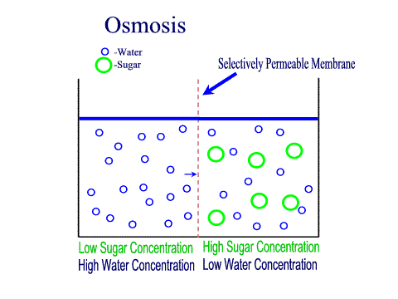
Osmosis
Diffusion of water through a selectively permeable membrane (cell membrane)

Slide 7
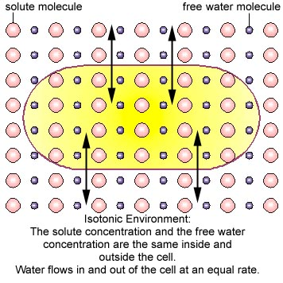
Isotonic Solution
ISO: equal
Concentration is equal on both sides of membrane

Slide 8
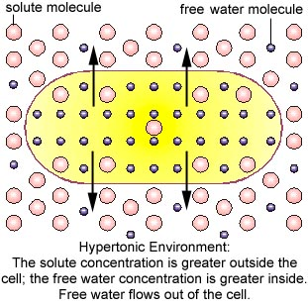
Hypertonic Solution
HYPER: greater
Solution has more solutes (particles) than the other side of membrane (inside the cell)

Slide 9
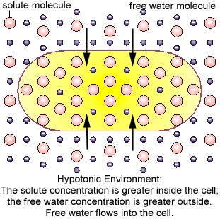
Hypotonic Solution
HYPO: less
Solution has less solutes (particles) than the other side of membrane (inside of cell)

Slide 10
Passive Transport
Movement along the concentration gradient
No ENERGY required!!!
EX: Diffusion & Osmosis

Slide 11
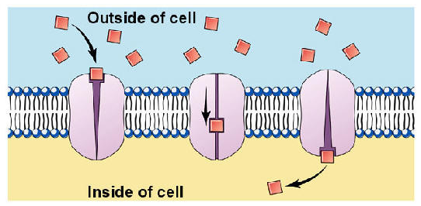
Facilitated Diffusion
Cell membrane channel proteins help move molecules across the membrane
EX: Glucose

Slide 12
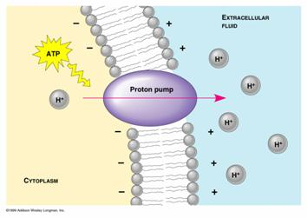
Active Transport
Movement of molecules AGAINST the concentration gradient
Requires ENERGY!!!

Slide 13
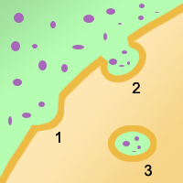
Endocytosis
Taking materials into the cell by infoldings of the cell membrane

Slide 14
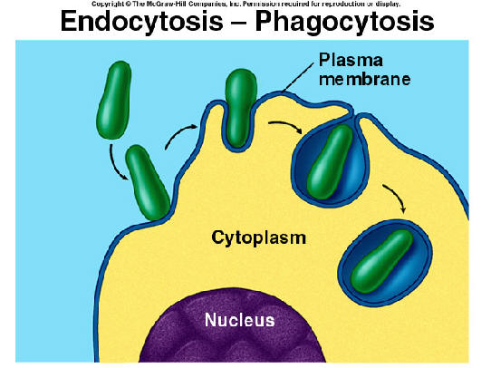
Phagocytosis
Endocytosis by surrounding a particle and packaging it in a food vacuole
Cell eating!!!

Slide 15
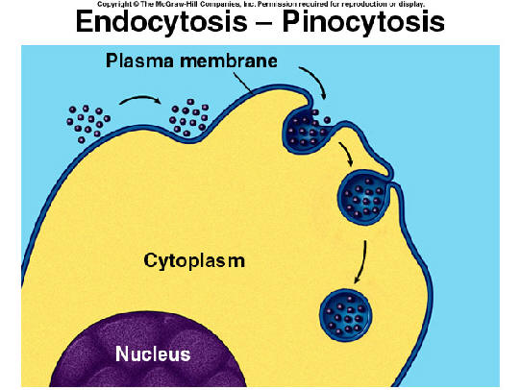
Pinocytosis
Tiny pockets from along cell membrane, fill with liquid, then pinch off forming vacuoles in cell
Cell Drinking!!!!

Slide 16
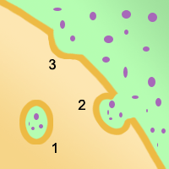
Exocytosis
Vacuole fuses with cell membrane, forcing contents of vacuole out of the cell
Cell removing molecules!!!

