Slide 1
The Plasma Membrane
TSW understand the physical structure and functions of the cell membrane

Slide 2
What is the plasma membrane?
A flexible boundary between the cell and its environment which maintains HOMEOSTASIS within the cell
**Remember that HOMEOSTASIS is a state of balance/equilibrium within the cell.

Slide 3
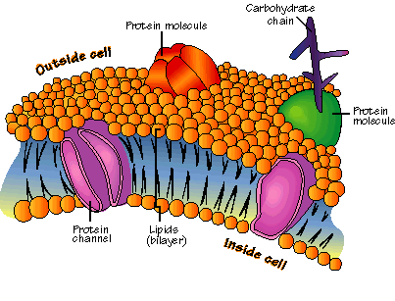
How does it maintain homeostasis?
Allows nutrients, such as glucose, amino acids, & lipids, to enter the cell
Removes excess nutrients & waste products from the cell

Slide 4
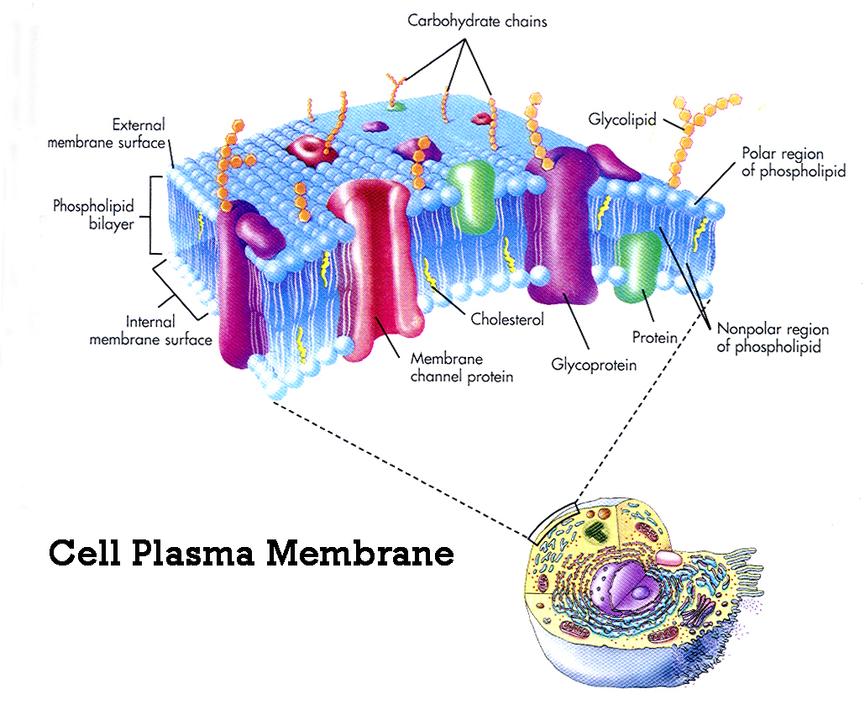
Characteristics of the Plasma Membrane
Selectively Permeable
Fluid & flexible
Mosaic of many different components

Slide 5
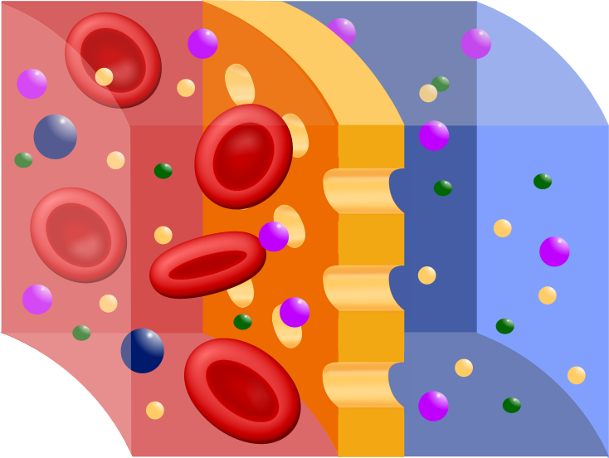
What is selective permeability?
The membrane allows some molecules to pass through, while keeping others out (i.e. like a window screen at your house…air can enter but bugs cannot)

Slide 6
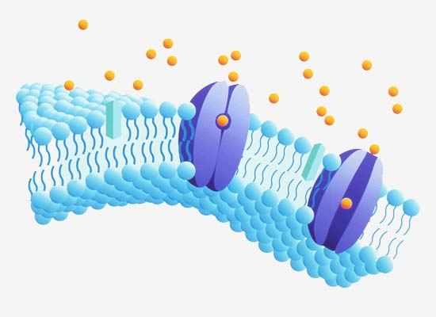
Functions of the Plasma Membrane
Regulate what enters and leaves the cell
Acts as a barrier between the cell & its environment
Communicates with other cells by sending & receiving signals

Slide 7
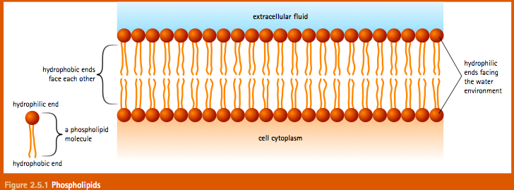
Structure of the Plasma Membrane
Composed of a phospholipid bilayer (2 layers of phospholipids back-to-back)

Slide 8
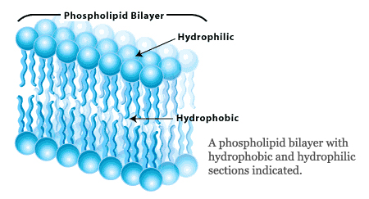
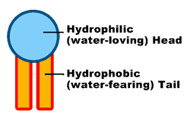
The Phospholipid Bilayer
Polar phosphate group allows the membrane to interact with its watery environment
Non-polar fatty acid tails avoid water
Hydrophilic: water-loving
Hydrophobic: water-fearing

Slide 9
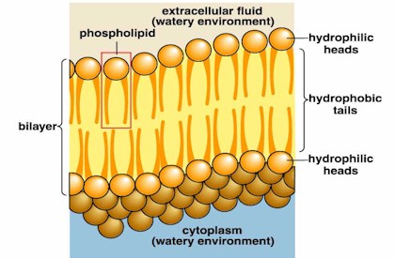
The Phospholipid Bilayer (cont.)
2 layers of phospholipids make a sandwich with the heads facing the watery environments outside & inside of the cell & the tails forming the interior of the membrane

Slide 10
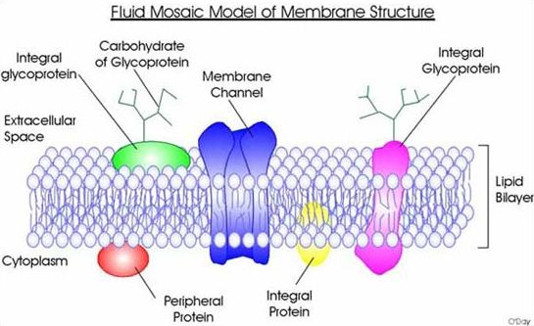
Fluid Mosaic Model
Fluid: the phospholipids move freely within the membrane, it is not stiff or rigid
Mosaic: composed of many parts (fats, proteins, etc)

Slide 11
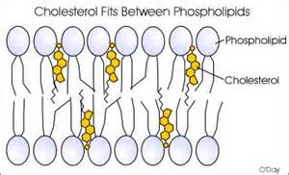
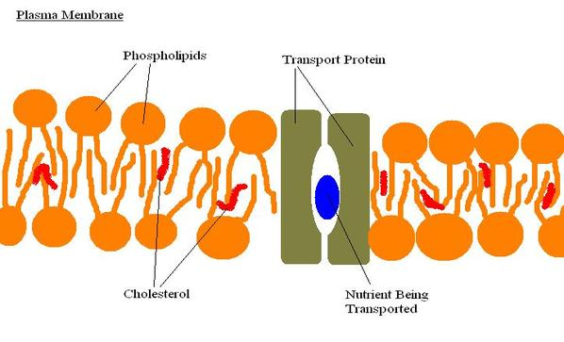
Components of the Membrane
Cholesterol: stabilize the membrane by keeping fatty acid tails from sticking to each other
Transport Proteins: regulate what enters & leaves the cell
Carbohydrates: communication with other cells

Slide 12
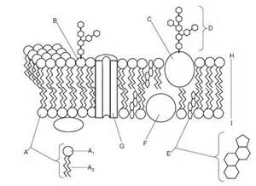
Label the Membrane
Word Bank:
*Carbohydrate Chain
*Cholesterol
*Glycoprotein
*Lipid Tails
*Peripheral Protein
*Phosphate Head (2x)
*Phospholipid
*Phospholipid Bilayer
*Transport/Channel Protein

